Slide 1
Unit – 5
Component & Deployment Diagram

Slide 2
Implementation Diagram
It show the implementation phase of system development such as the source code structure and the run time implementation structure
It is high level diagram also called as physical diagram
Two types:-
  Component diagram
  Deployment diagram

Slide 3
Component Diagram
It does not describe the functionality of the system but it describes the components used to make those functionalities.
It model the physical components such as executables, libraries, tables, files and documents.
A Component represents the physical packaging of logical elements, such as classes, interfaces, and collaborations.
Logical modeling help to visualize, specify, and document the collaborations. Physical modeling is used to construct the executable system.
Component diagrams can also be described as a static implementation view of a system. Static implementation represents the organization of the components at a particular moment.

Slide 4
Component Diagram
In the UML, all these physical things are modeled as components. A component is a physical thing that conforms to and realizes a set of interfaces, thus interfaces bridge logical and physical models.
You also can have file components that represent the source code files of an application or document files that represent, for example, the user interface files such as HTML or JSP files.
Finally, you can use components to represent even the database tables of a system as well!
Component diagrams are used during the implementation phase of an application.

Slide 5

Elements
Component: The objects interacting with each other in the system. Depicted by a rectangle with the name of the object in it, preceded by a colon and underlined.

Slide 6


A component is shown as a classifier rectangle with the keyword «component». (UML 2.0 notation)
‘WeatherServices’ component
Optionally, a component icon similar to the UML 1.4 icon can be displayed in the top right corner of the component rectangle. If the icon symbol is shown, the keyword «component» may be omitted.
UserServices component
A component may be manifested by one or more artifacts, and in turn, that artifact may be deployed to its execution environment. A deployment specification may define values that parameterize the component’s execution.

Slide 7
Interface
It is a collection of operations that specify a service that is provided by or requested from a class or component.
<<Interface>>
Name
methods

Slide 8

A provided interface is the one that is either
realized directly by the component itself, or
realized by one of the classifiers realizing component, or
is provided by a public port of the component.
Ball-socket notation is used to show interface
The provided interfaces of a port describe requests to the classifier that other classifiers may make through this port. The required interfaces of a port describe the requests that may be made from the classifier to its environment through the port.
Weather Services component provides (implements)
Weather Forecast interface

Slide 9

A required interface is either
designated by usage dependency from the component itself, or
designated by usage dependency from one of the classifiers realizing component, or
is required by a public port of the component.
User Services component requires IOrderServices interface

Slide 10
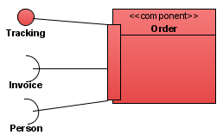

Port
A port specifies an interaction point through which a classifier can communicate with its environment, with other classifiers, or with its internal parts.
A Port is a specific window into an encapsulated component accepting messages to and from the component conforming to specified interface.
Port is shown as a small square placed either overlapping the boundary of the rectangle denoting the encapsulated classifier, or it may be shown inside that rectangle symbol. The name of the port is placed near the small square.
Ports can support unidirectional communication or bi-directional communication.

Slide 11
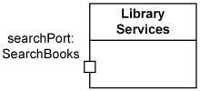

The type of a port may be shown after the port name, separated by colon ":".
Multiplicity of a port (if any) is shown after the port name in square brackets. Both name and multiplicity of port are optional.
Library Services class has port searchPort with SearchBooks type.
Library Services class has 1 to 6 searchPort ports.
A provided interface may be shown using the "lollipop" notation attached to the port. A required interface may be shown using the "socket" notation attached to the port.

Slide 12
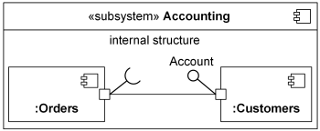
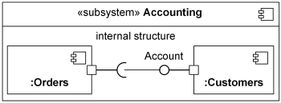
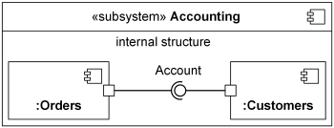
or parts without ports.

Slide 13
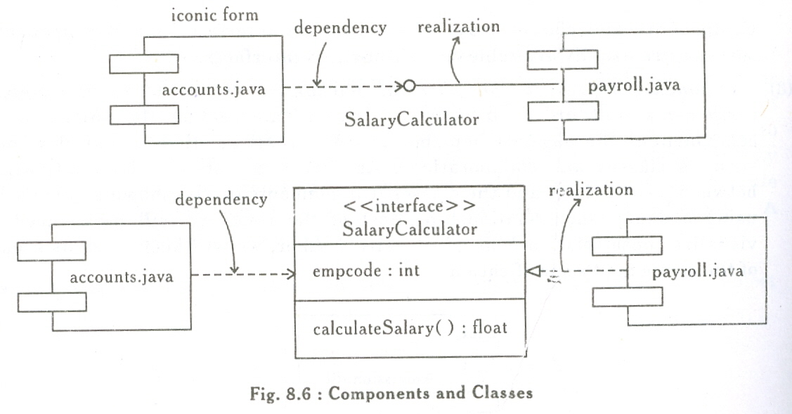
Relationship
Relation/Association: Similar to the relation/association used in class diagrams
(dependency) (Realization)

Slide 14
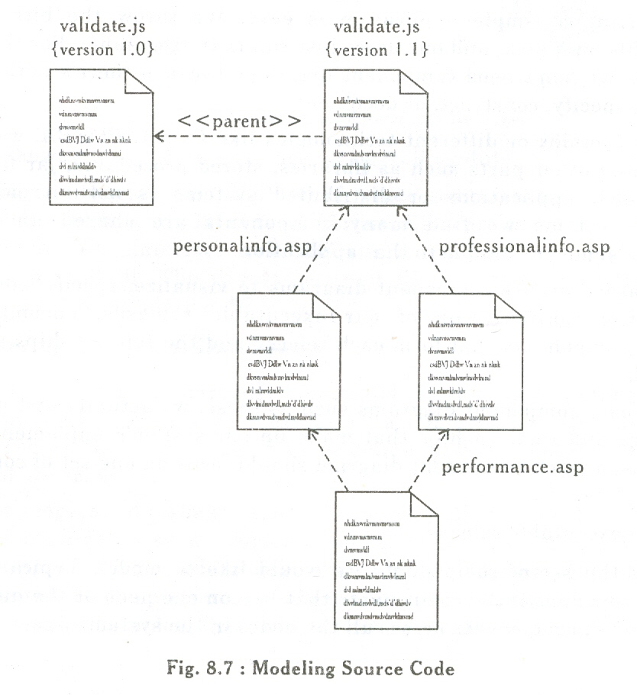
Uses of Component diagram
Modeling Source Code: In application, we organize the files into larger groups. Sometimes we update some files or create new version of file. Component diagrams help to visualize these source code files and their relationships.

Slide 15
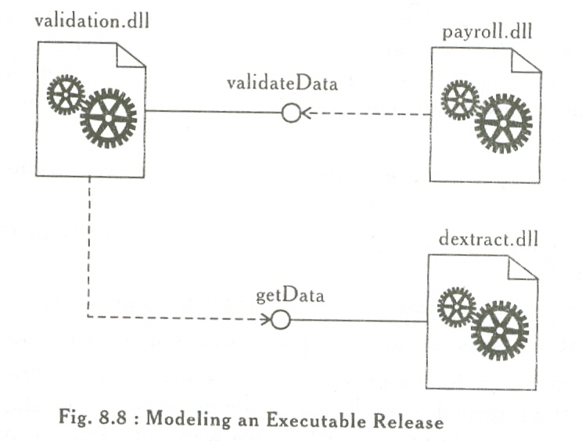
Modeling Executable releases: Releasing a simple application is easy but for complex technologies we need main executable, libraries, stored procedures. Component diagrams help to visualize, specify, construct and document the configuration of executable releases, consisting the deployment components that form each release and the relationships among those components.

Slide 16
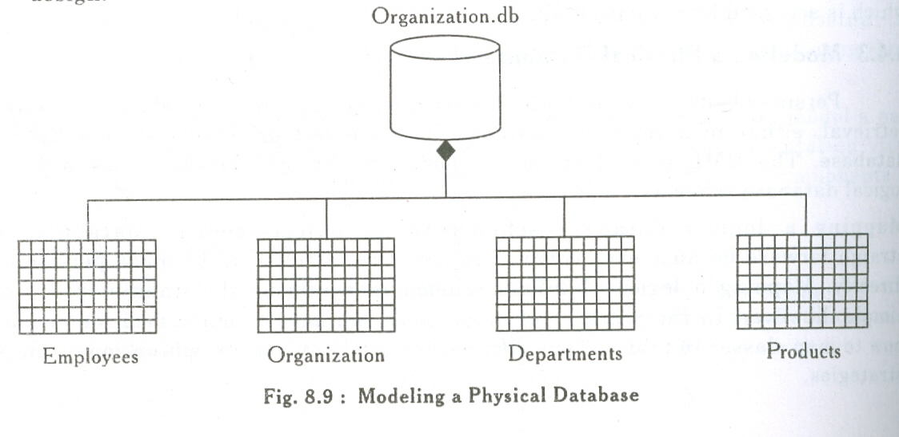
Modeling physical databases: Mapping a logical database schema to a relational database is not so simple. In presence of inheritance decisions should be made about how to map classes to tables.
  Define a separate table for each class
  Collapse inheritance lattices so that all instances of any class in a hierarchy have the same state
  Separate parent and child states into different tables

Slide 17
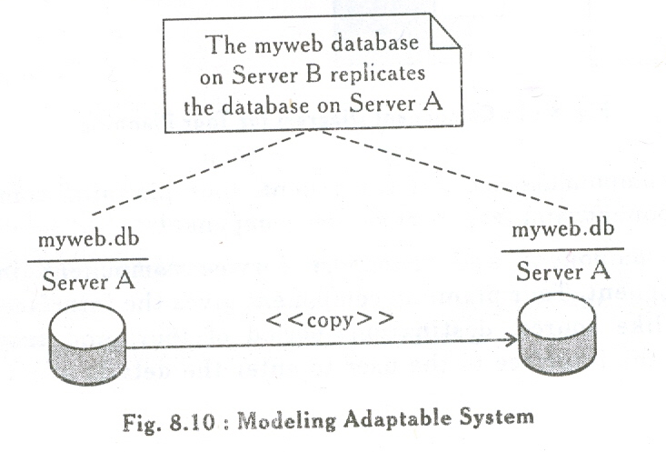
Modeling adaptable systems: sometimes due to complex operations the database is separated on different servers.

Slide 18
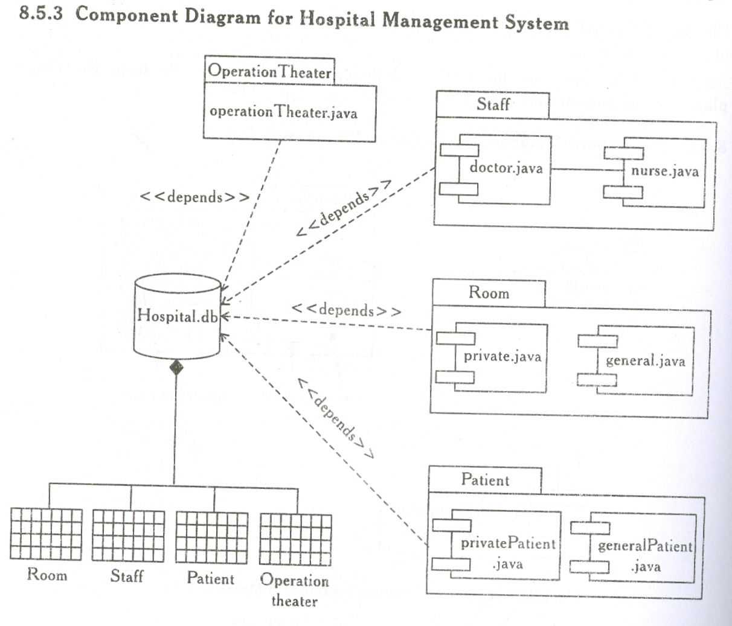

Slide 19
Example: Online shopping system
WebStore subsystem contains three components related to online shopping - Search Engine, Shopping Cart, and Authentication. Search Engine component allows to search or browse items by exposing provided interface Product Search and uses required interface Search Inventory provided by Inventory component. Shopping Cart component uses Manage Orders interface provided by Orders component during checkout. Authentication component allows customers to create account, login, or logout and binds customer to some account.
Accounting subsystem provides two interfaces - Manage Orders and Manage Customers. Delegation connectors link these external contracts of the subsystem to the realization of the contracts by Orders and Customers components.
Warehouses subsystem provides two interfaces Search Inventory and Manage Inventory used by other subsystems and wired through dependencies.

Slide 20
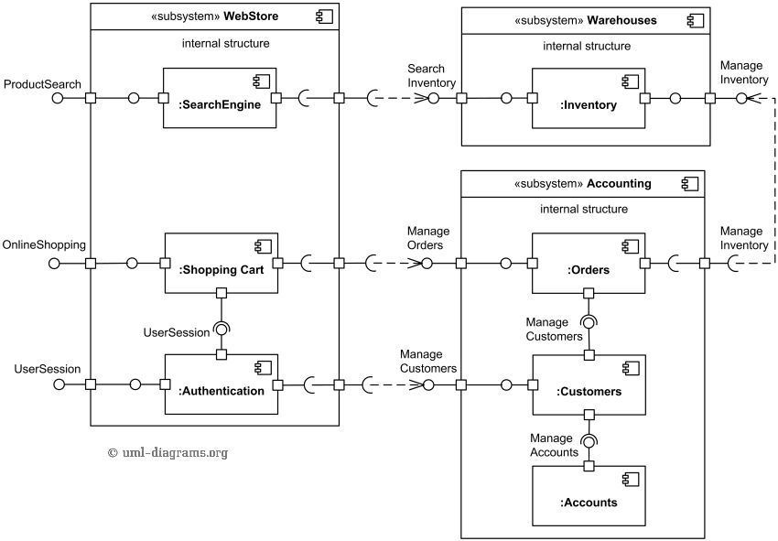

Slide 21
Deployment Diagram
The deployment diagram captures the configuration of the runtime elements of the application.
It shows the topology of processors and devices on which the software executes.
With UML, we use deployment diagrams to visualize the static aspect of the physical nodes and their relationships and to specify their details for construction.
It shows allocation of processes to processors in physical design, thus known as process diagram.

Slide 22
Elements
Processor:- Hardware capable of executing programs. It is represented as shaded cube with a name of the object. It can have list of processes on it.
Device:- hardware helping in execution of applications
Production
Server
Modem

Slide 23
Connection:- similar to the relation/association used in class diagrams to define the interconnection between nodes.
Deployment diagram addresses the distribution, delivery, and installation of the parts that make up the physical system.

Slide 24
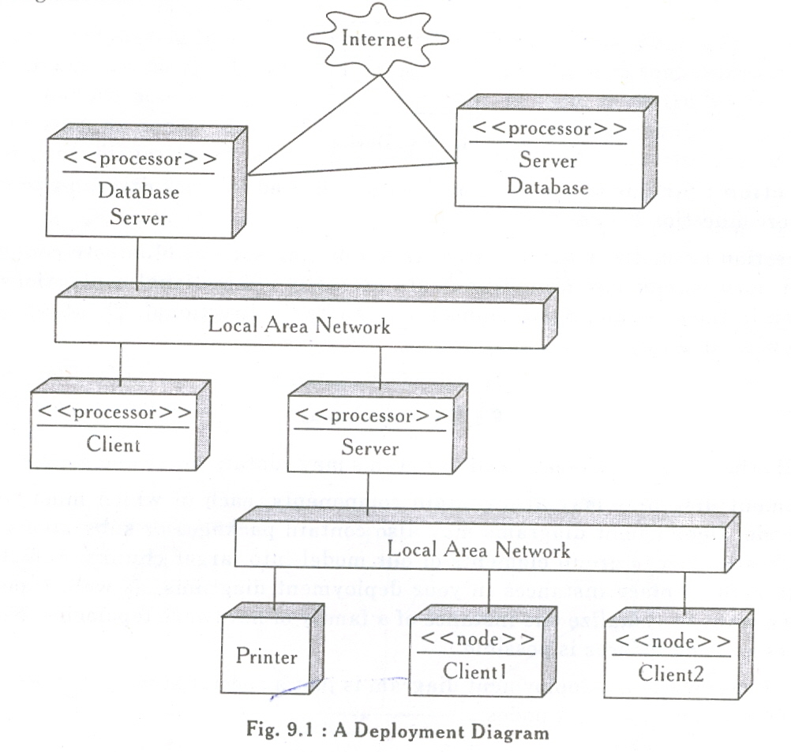

Slide 25
Common Uses
Model Embedded systems:- Embedded systems involve software that controls devices such as motors, actuators, and displays and is controlled by external stimuli (sensor input, movement, temperature changes). Deployment diagram can be used to model the devices and processors that comprise an embedded system.
Thus, we should consider project hardware and software groups interaction.

Slide 26
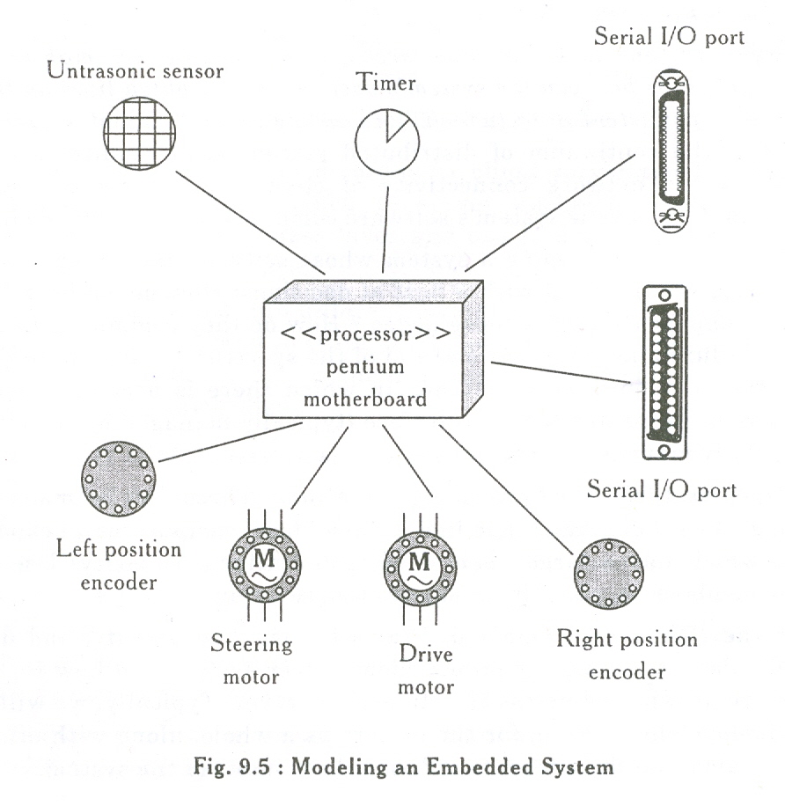

Slide 27
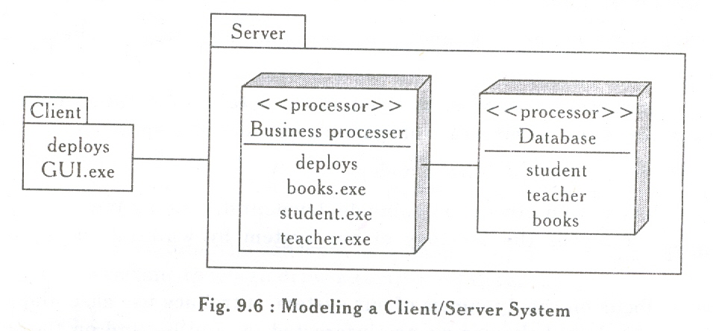
Model Client/Server system:- A client/server system focus on making clear separation between the system’s user interface and the system’s persistent data. We should decide about the network connectivity of clients to servers and about the physical distribution of software components across the nodes.

Slide 28
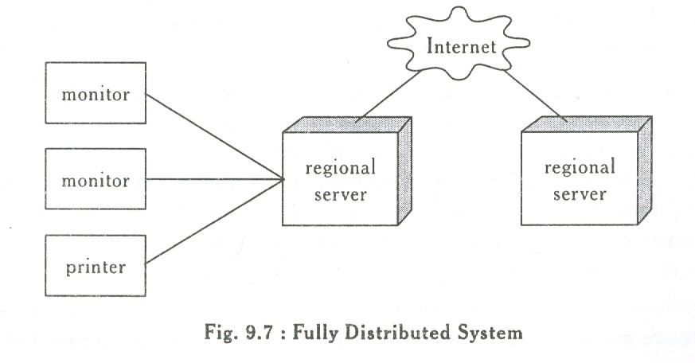
Model fully distributed system:- They are widely distributed encompassing multiple levels of servers. Nodes can be added or deleted as per requirement.

Slide 29
Relation between deployment and component diagram
The components in a component diagram are contained in the deployment diagram. Hence, components provide the application functionality, and deployment elements provide the necessary environment for the components to execute in.
The basic deployment element is the node. A node can represent a multitude of components.

Slide 30
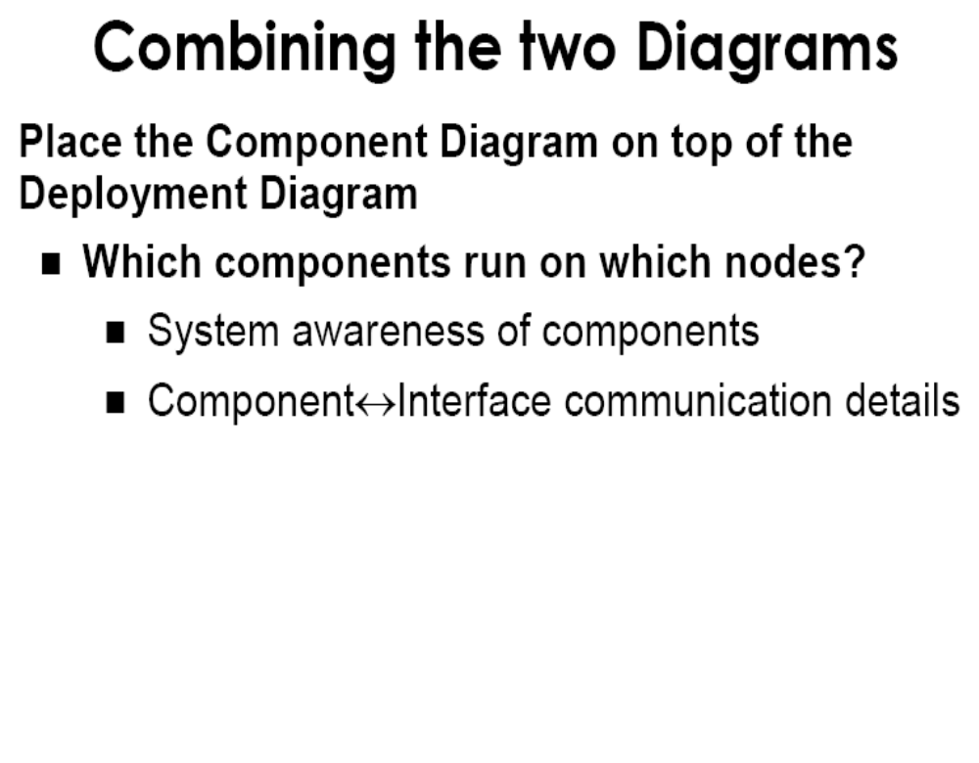

Slide 31
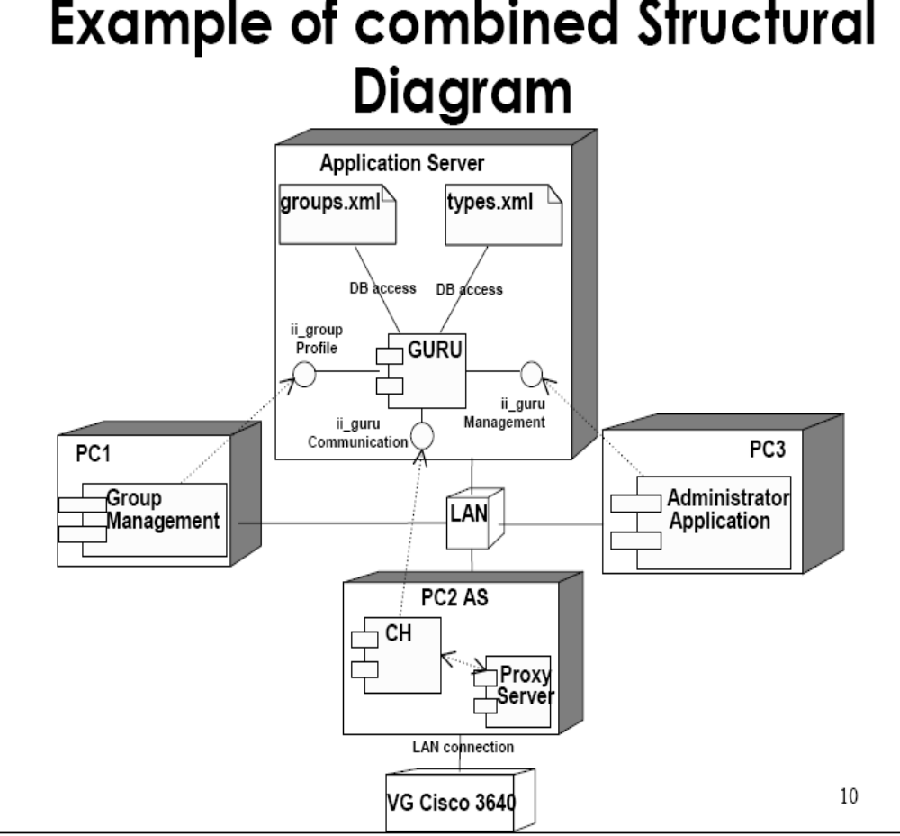

Slide 32
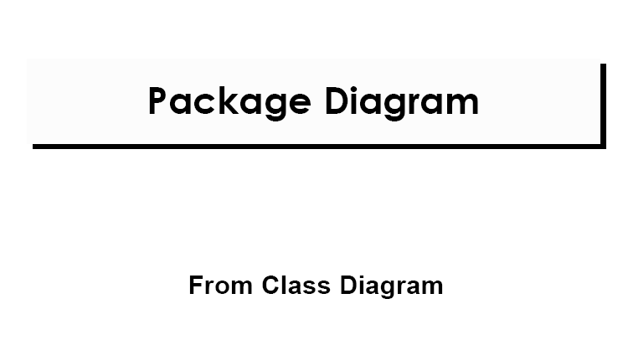

Slide 33
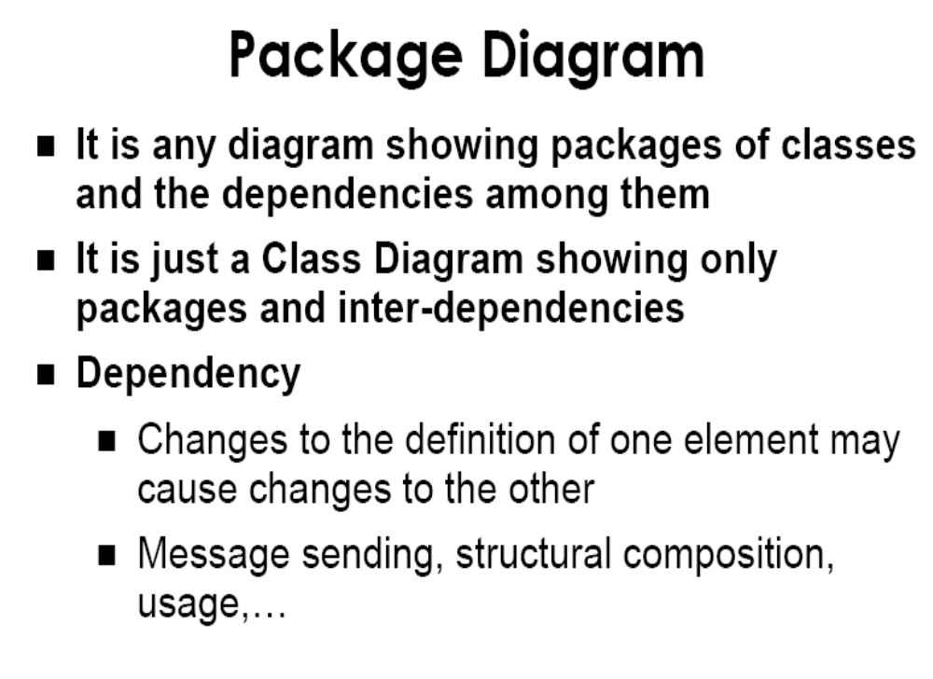

Slide 34
